Slide 1

Multivariate Analysis Visualization
Sili Fan WCMC statistician

Slide 2
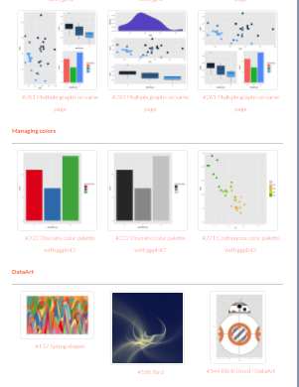
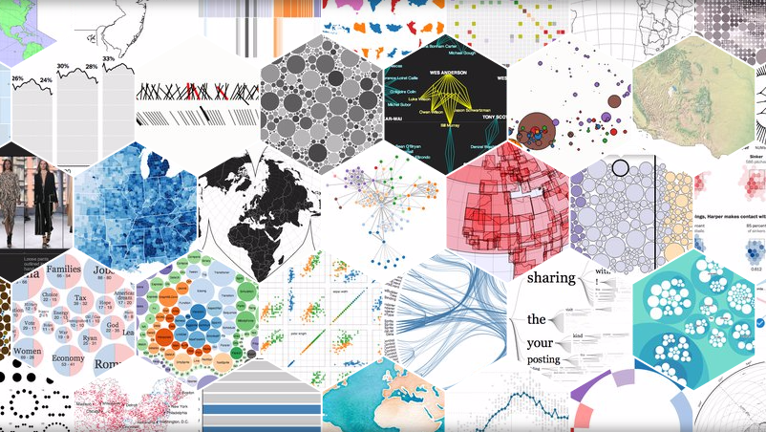
Visualization
Software/ Packages
Almost all the statistical analysis tools provide data visualization
Standardization + Flexibility + Publishability
Free Online: Metabox, Metaboanalyst, BoxPlotR
Commercial: SIMCA, SPSS, Stata
Computing language R package: ggplot2, ReporteRs
Computing language JS library: D3.js
Commercial: Tableau, plotly
Computing language R package: ggsci, pubr, ggpubr
D3.js
ggplot2

Slide 3
Study Objective
Scatter plot
Score Plot
Loadings Plot
Biplot
Interactive plot
Dendrogram + Heatmap

Slide 4
Data Set Characteristic and Visualization Obstacle
Multiple Factors
Multiple Levels
Dozens to Hundreds of Compounds
High Throughput
High Dimensionality
Complexity
Too much labeling
How to visualize them at one glance (one dimension)
NKI breast cancer dataset (PAM50 genes)
Premenopausal
ES Status
Node Status
HER2 Status
PR Status
Tumor Size
Grade
Yes
No
Unknown
+ve
-ve
Unknown
+ve
-ve
Unknown
+ve
-ve
Unknown
+ve
-ve
Unknown
<=2
>2
Unknown
1
2
3
Unknown
7 Factors
3
3
3
3
3
3
4 Levels
63 Genes 337 Samples
https://bmcmedgenomics.biomedcentral.com/articles/10.1186/s12920-015-0129-6

Slide 5
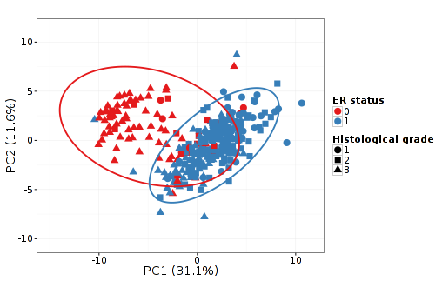
Data Set Characteristic and Visualization Obstacle
Multiple Factors
Multiple Levels
High Dimensionality
Complexity
NKI breast cancer dataset (PAM50 genes)
Premenopausal
ES Status
Node Status
HER2 Status
PR Status
Tumor Size
Grade
Yes
No
Unknown
+ve
-ve
Unknown
+ve
-ve
Unknown
+ve
-ve
Unknown
+ve
-ve
Unknown
<=2
>2
Unknown
1
2
3
Unknown
color
shape
size
transparency
border
5 dimensions
priority
Highlight Only the Necessary Characters when using Scatter plot
Don’t pick up all the dimensions
Avoid overloading
https://bmcmedgenomics.biomedcentral.com/articles/10.1186/s12920-015-0129-6

Slide 6
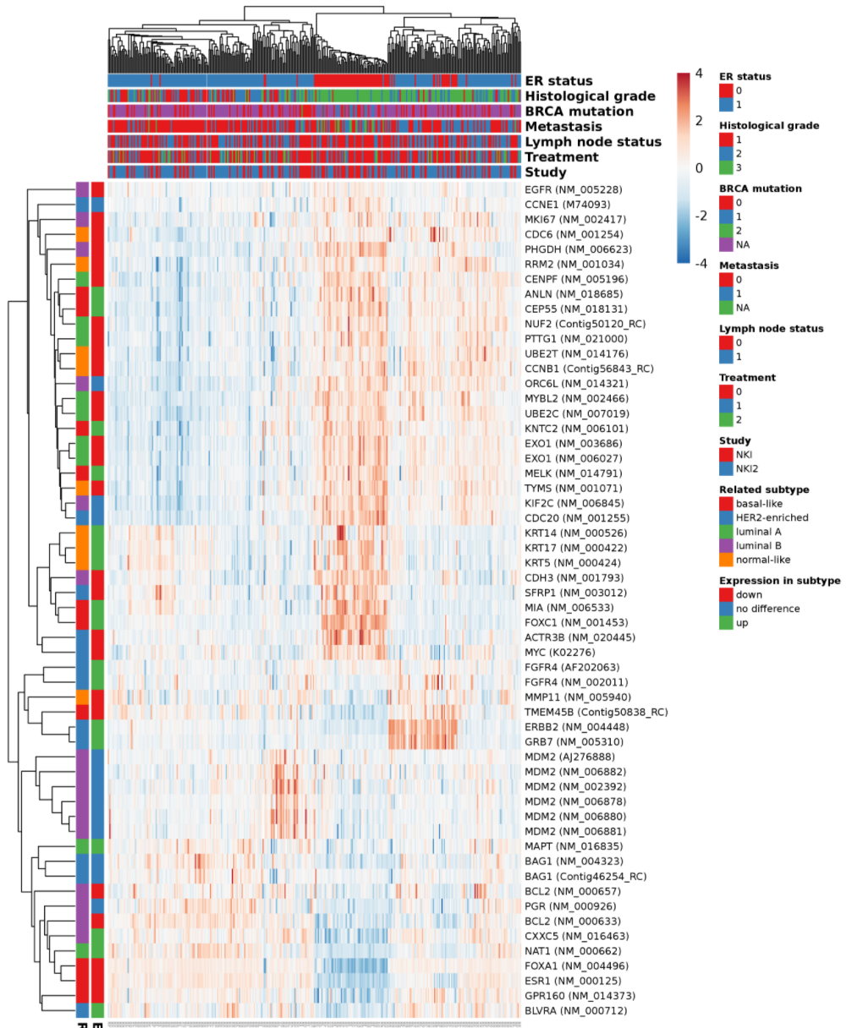
Data Set Characteristic and Visualization Obstacle
Multiple Factors
Multiple Levels
High Dimensionality
Complexity
NKI breast cancer dataset (PAM50 genes)
Premenopausal
ES Status
Node Status
HER2 Status
Yes
No
Unknown
+ve
-ve
Unknown
+ve
-ve
Unknown
+ve
-ve
Unknown
PR Status
Tumor Size
Grade
+ve
-ve
Unknown
<=2
>2
Unknown
1
2
3
Unknown
Good for data exploration and Interpretation
Good for selecting important factor
https://bmcmedgenomics.biomedcentral.com/articles/10.1186/s12920-015-0129-6

Slide 7
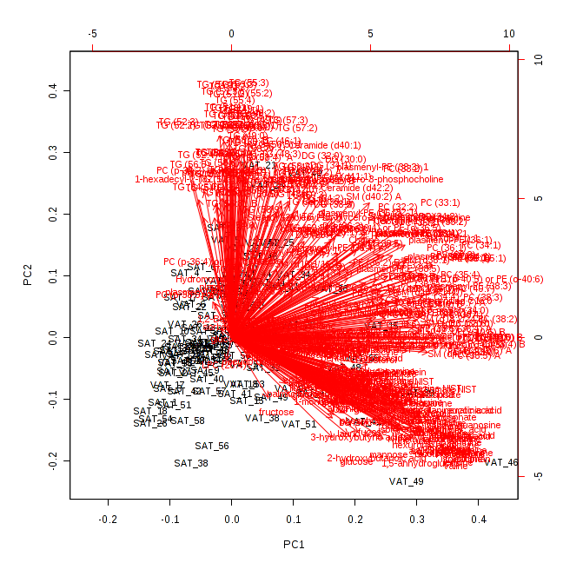
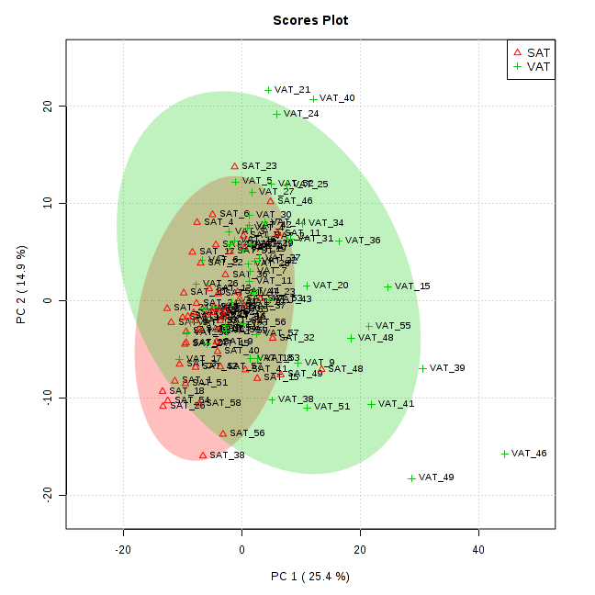
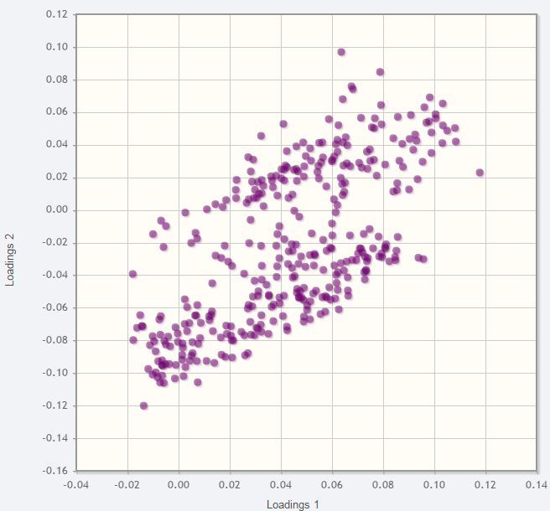
Data Set Characteristic and Visualization Obstacle
Dozens to Hundreds of Compounds
Too much labeling
Overlapping
Scores Plot
Bi-Plot
Loadings Plot
Not an ideal labeling strategy

Slide 8
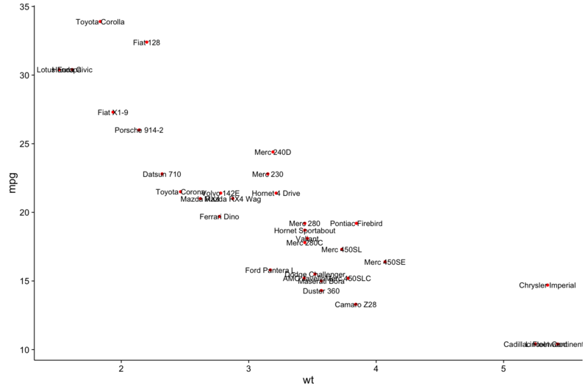
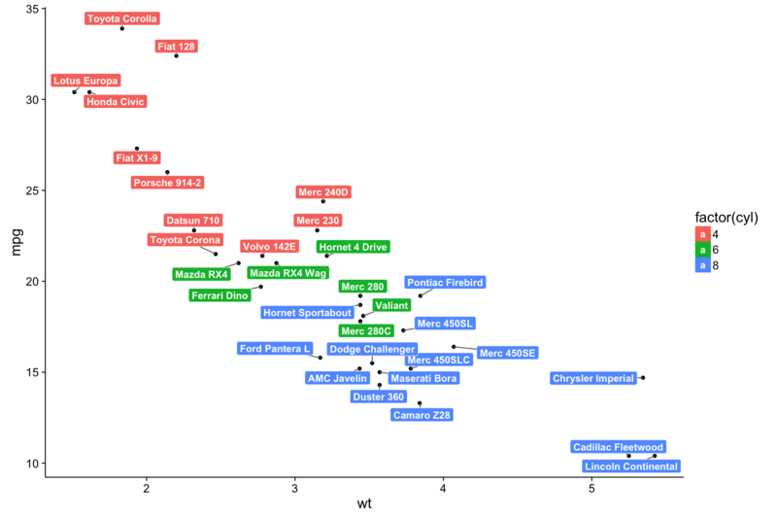
Data Set Characteristic and Visualization Obstacle
Dozens to Hundreds of Compounds
Too much labeling
repel the text labels away from each other
Good if there are not too many labels
Package ggrepel
https://cran.r-project.org/web/packages/ggrepel/vignettes/ggrepel.html

Slide 9
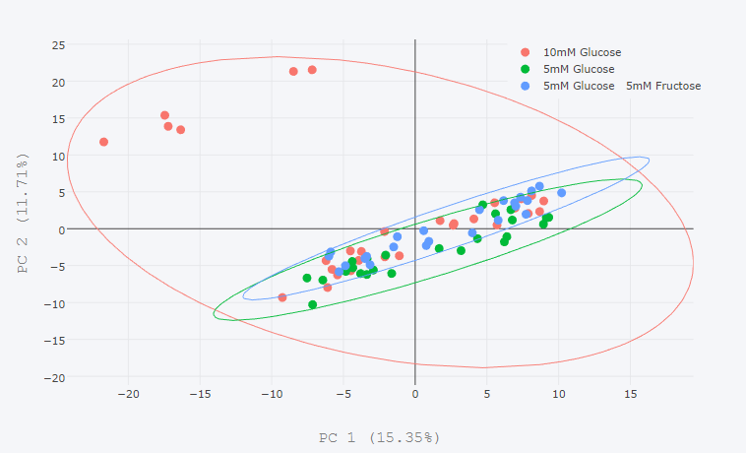
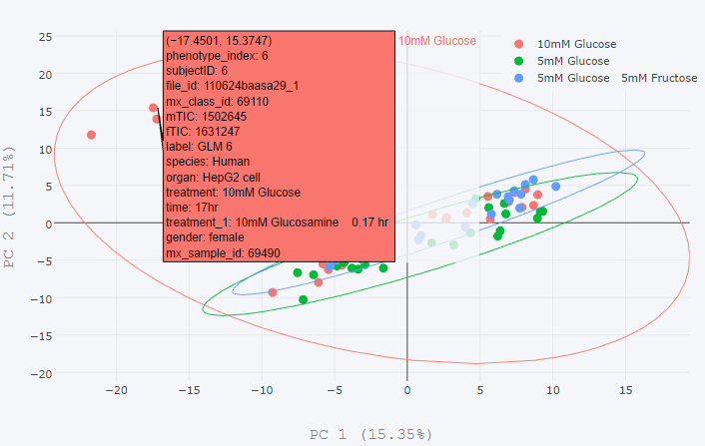
Data Set Characteristic and Visualization Obstacle
Dozens to Hundreds of Compounds
Too much labeling
2. Make it interactive
Good for Exploration (especially on biplot)
plotly can transform ggplot2 into interactive ggplot2!
https://plot.ly/r/

Slide 10
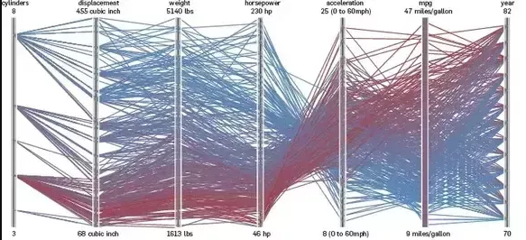
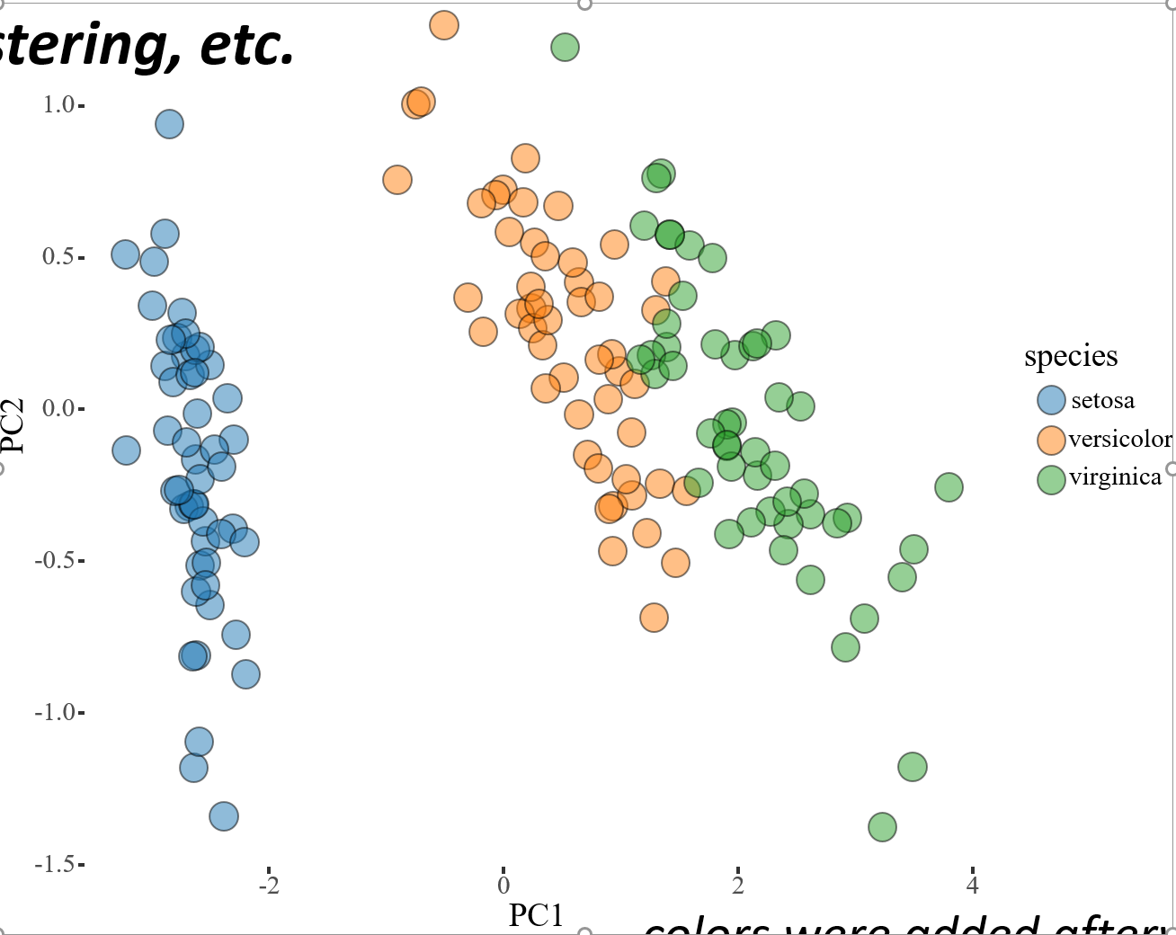
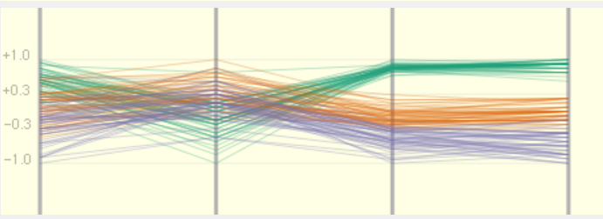
Data Set Characteristic and Visualization Obstacle
High Throughput
How to visualize them at one glance (one dimension)
Parallel coordinates
iPCA

Slide 11
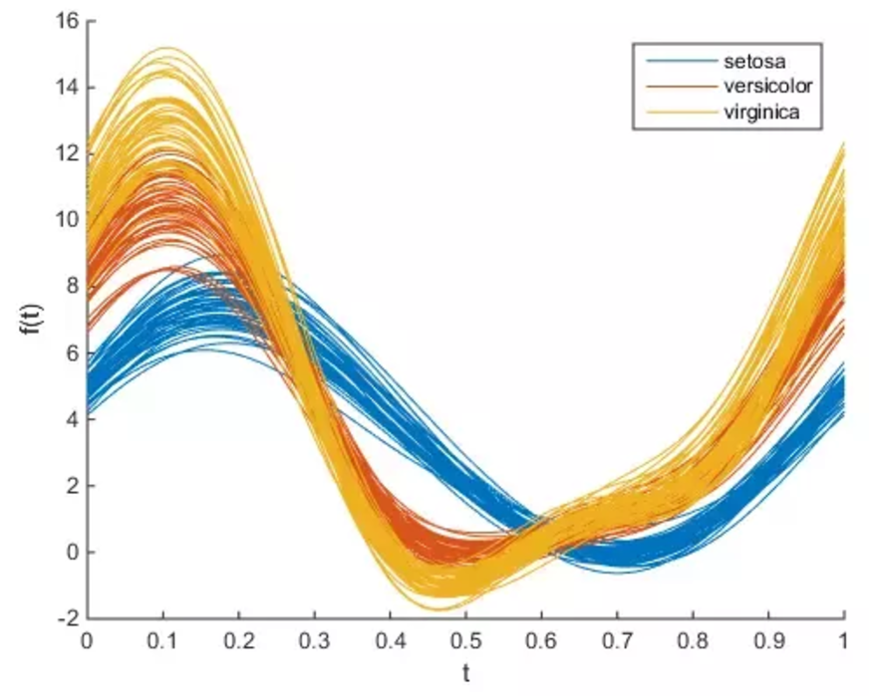

Data Set Characteristic and Visualization Obstacle
High Throughput
How to visualize them at one glance (one dimension)
2. Andrew’s plot
https://en.wikipedia.org/wiki/Andrews_plot

Slide 12
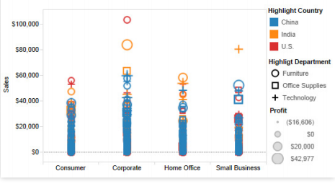
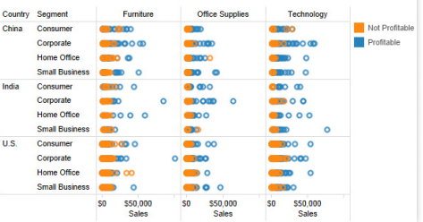
Conclusion remarks
A picture is worth a thousand words
Trade-off between amount of information, simplicity, and accuracy
Keep the necessary ones only and avoid overloading

